Slide 1
Lesson 10
Decoding Food Labels
© 2020 Johns Hopkins University

Slide 2
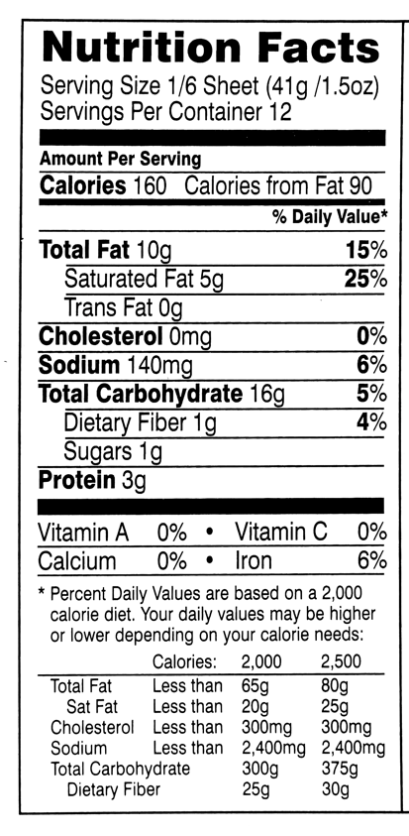
Nutrition Facts
Federal law requires this label on most foods. Includes information about:
Serving size
Calories
Fats and cholesterol
Sodium
Carbohydrates
Fiber
Sugars
Protein
Vitamins and minerals
Photo credit: CarrotNewYork.

Slide 3
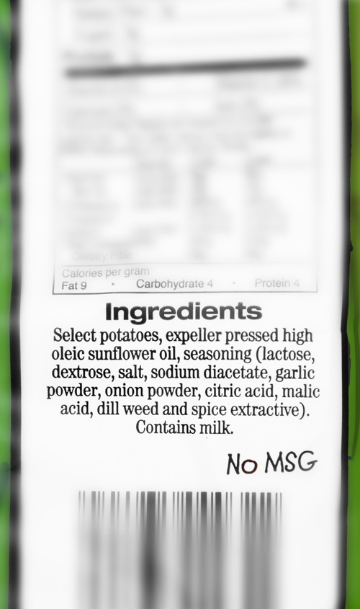
Ingredients
Listed in descending order by weight.
Photo credit: Michael Milli, CLF.

Slide 4
USDA Organic
Requirements include:
No synthetic fertilizers
Most pesticides are prohibited
No hormones or antibiotics in animals
No genetically engineered organisms
Animals must be able to express certain natural behaviors (e.g., grazing)
Image credit: United States Department of Agriculture. USDA Organic Seal.

Slide 5
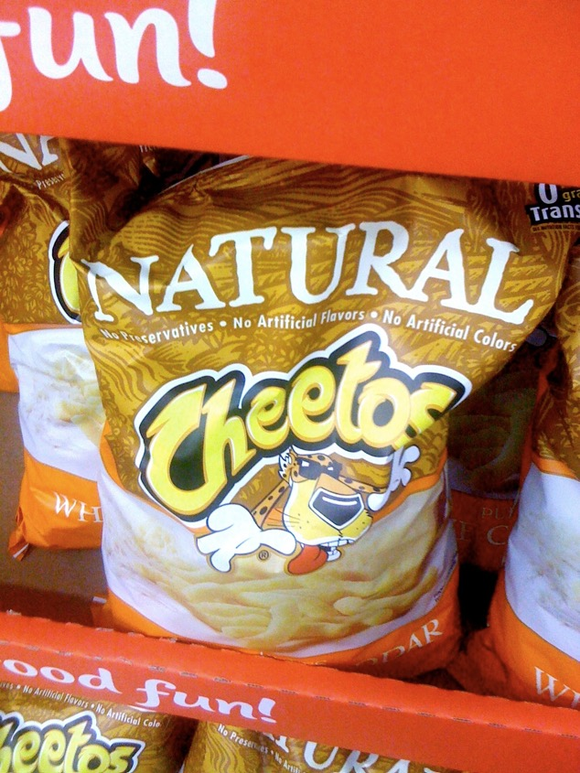
Natural
Should contain no:
Artificial colors
Artificial flavors
Synthetic ingredients
These FDA standards are not enforced.
USDA regulates the label on meat and poultry products.
Photo credit: Quinn Dombrowski, 2009. Flickr. Creative Commons CC BY-SA 2.0.

Slide 6
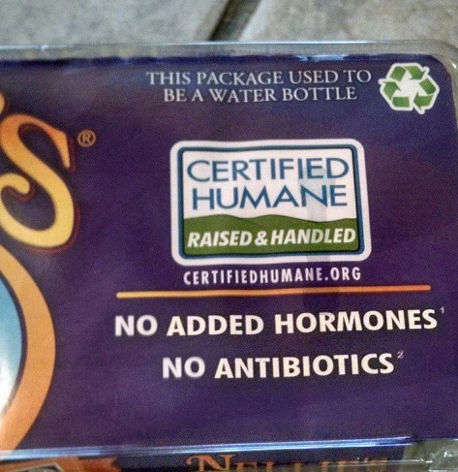
Third-party labels
Photo credit: James Duncan.

