Slide 1
Lesson 11
Marketing: Under the Influence
© 2020 Johns Hopkins University

Slide 2
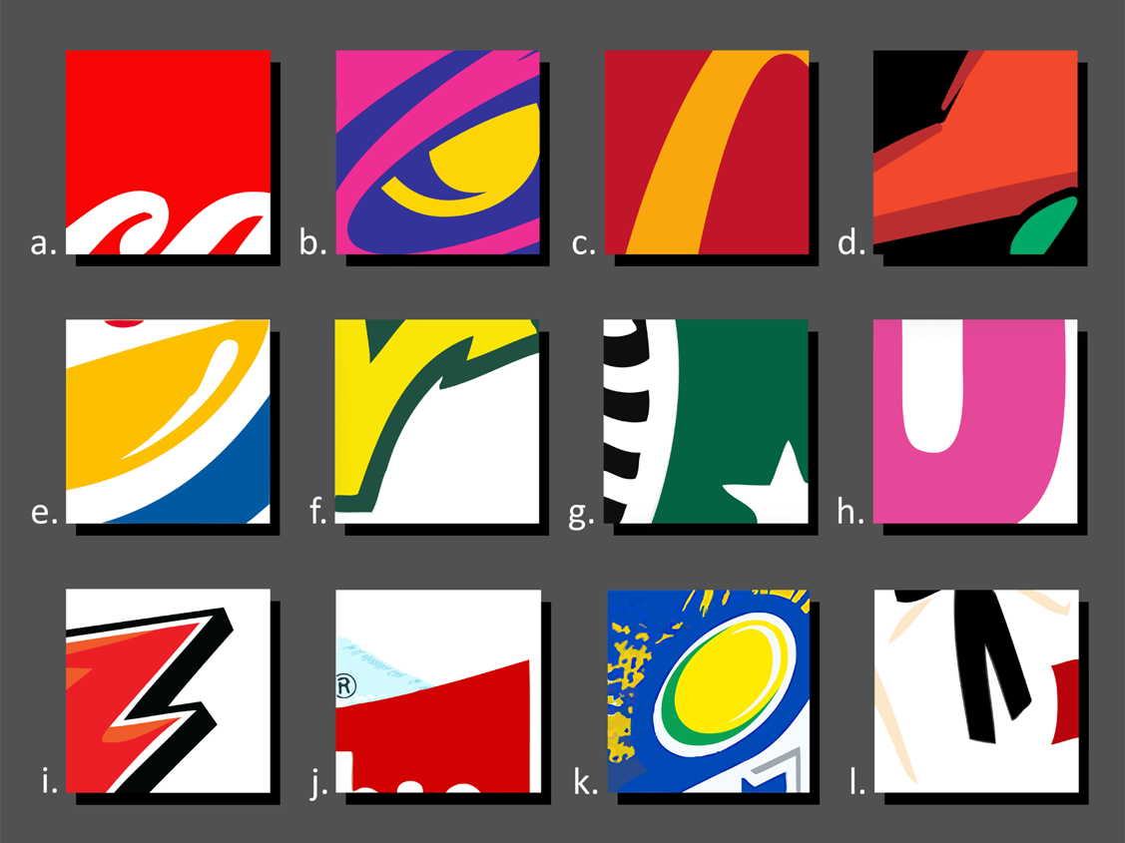
Test your brand recognition
How many companies and products can you identify based on just a piece of their logo?
All logos are trademarked and/or copyrighted.

Slide 3
Do you know the brand?
All logos are trademarked and/or copyrighted.

Slide 4
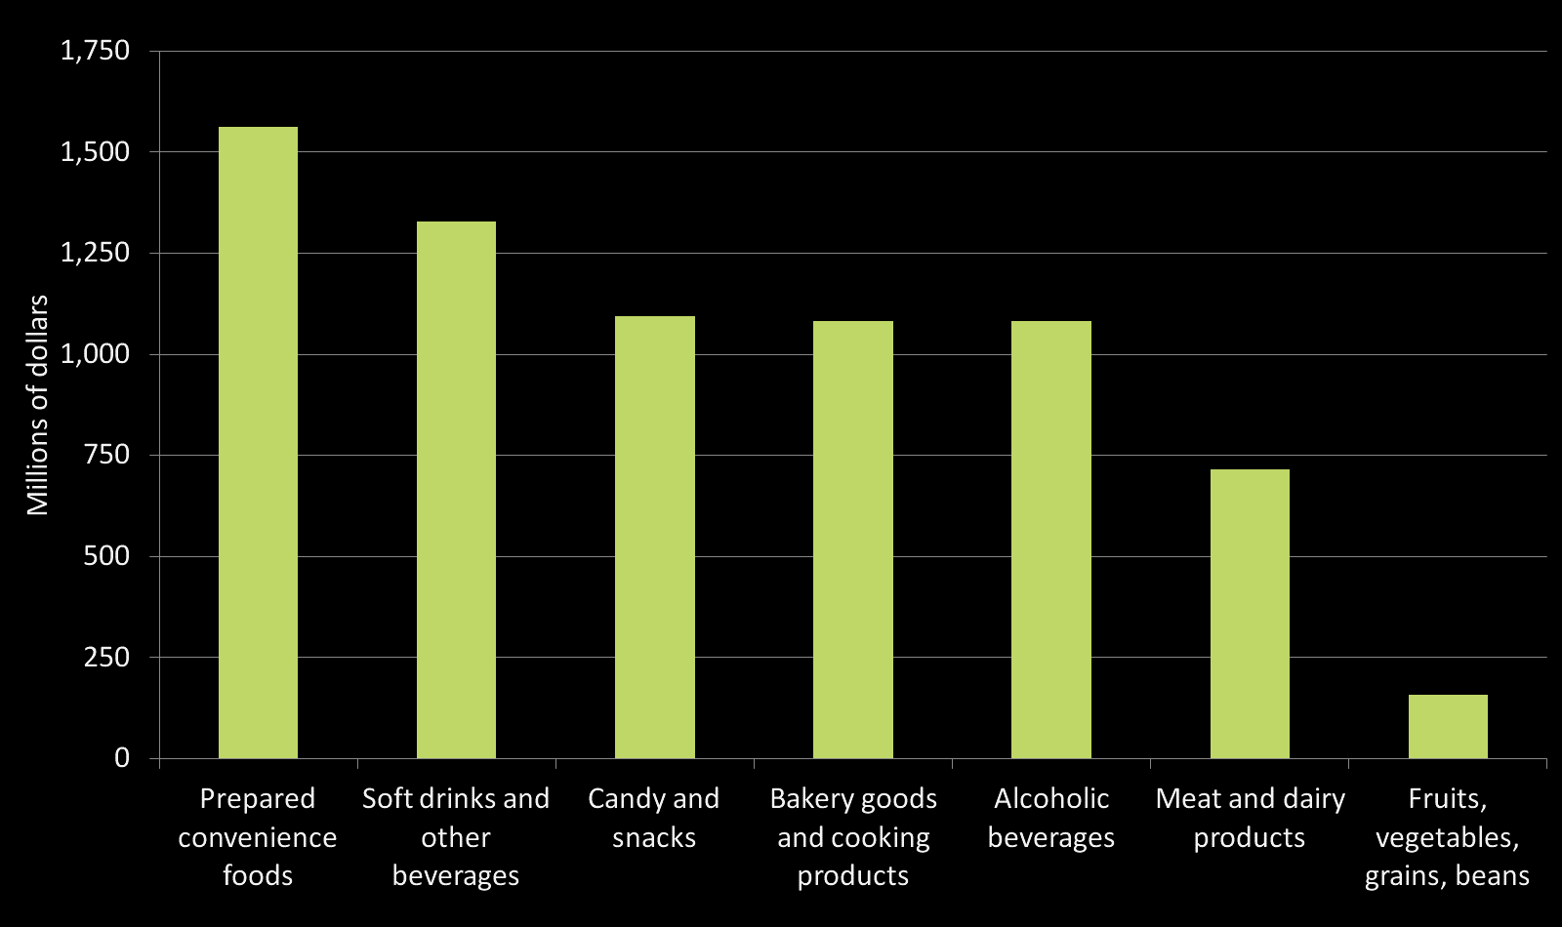
Food Advertising Spending
Annual spending by U.S. food and beverage manufacturers on advertising in 1997 (the last year industry-wide data were openly available)
Source: Gallo A. Food Advertising in the United States. In: America’s Eating Habits: Changes and Consequences. USDA Economic Research Service; 1999:173-180.

