Slide 1
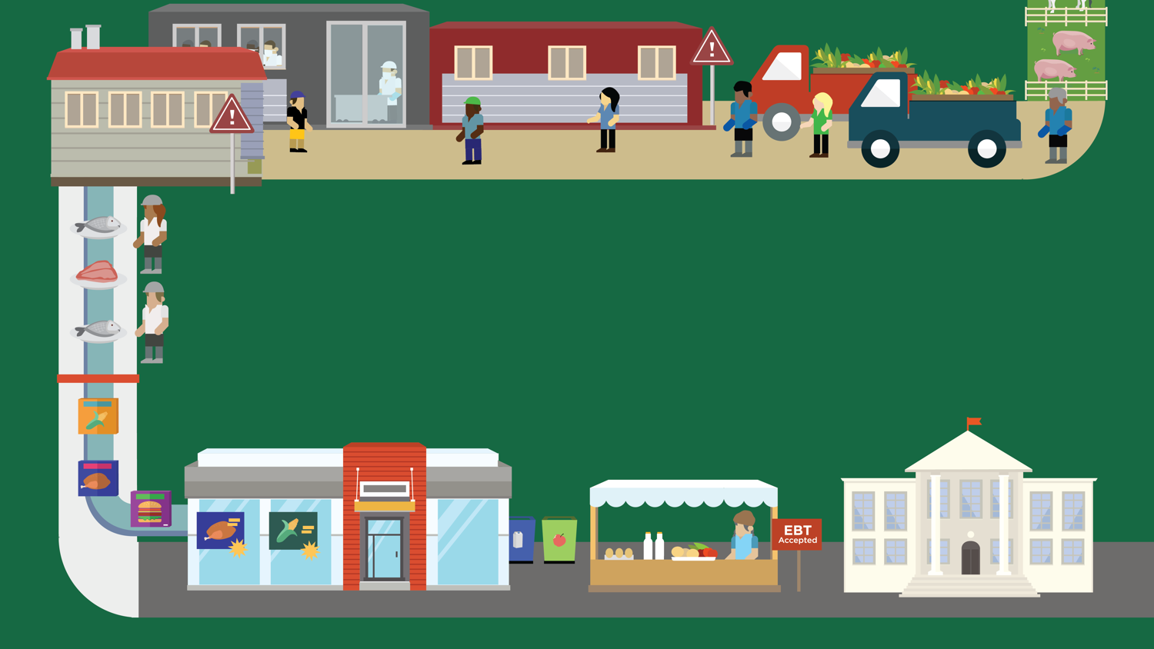
Lesson 12
Why We Eat What We Eat
© 2020 Johns Hopkins University

Slide 2
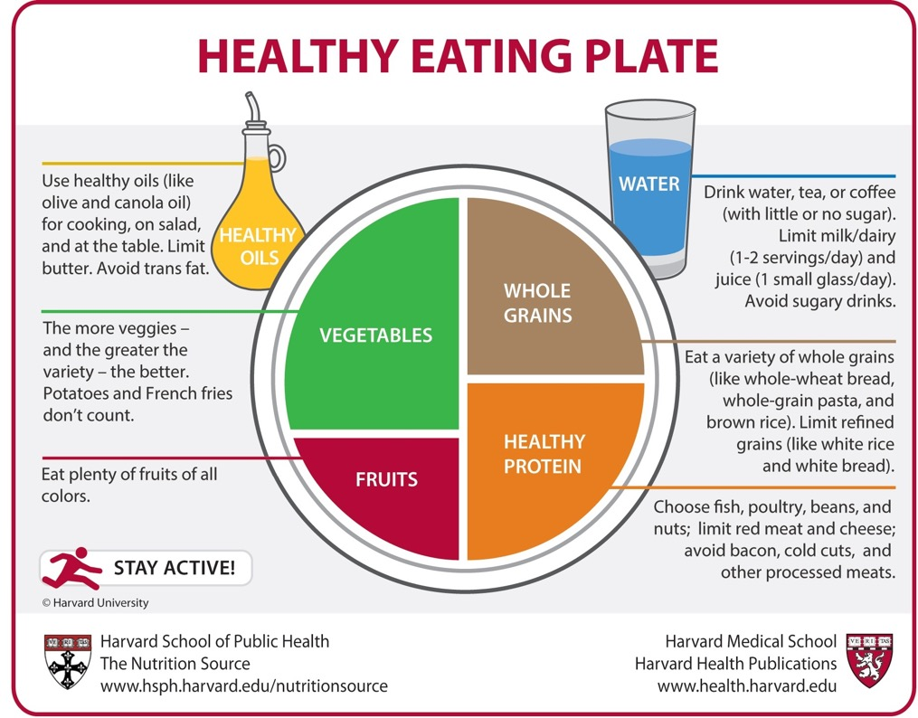
Healthy Reading plate
Copyright © 2011, Harvard University. For more information about The Healthy Eating Plate, please see The Nutrition Source, Department of Nutrition, Harvard School of Public Health, www.thenutritionsource.org, and Harvard Health Publications, www.health.harvard.edu.

Slide 3
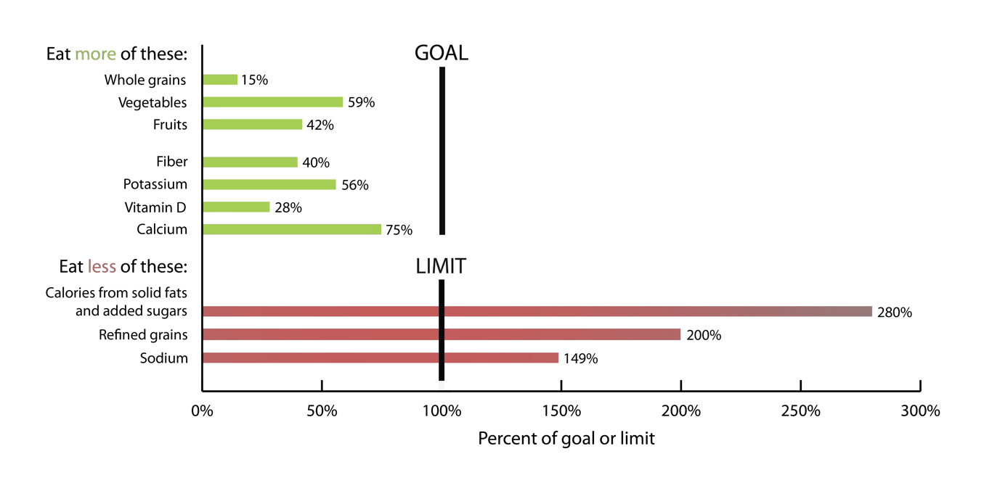
How do typical American diets compare to U.S. dietary guidelines?
Graph adapted from: U.S. Department of Health and Human Services, U.S. Department of Agriculture. Dietary Guidelines for Americans, 2010.

