Slide 1
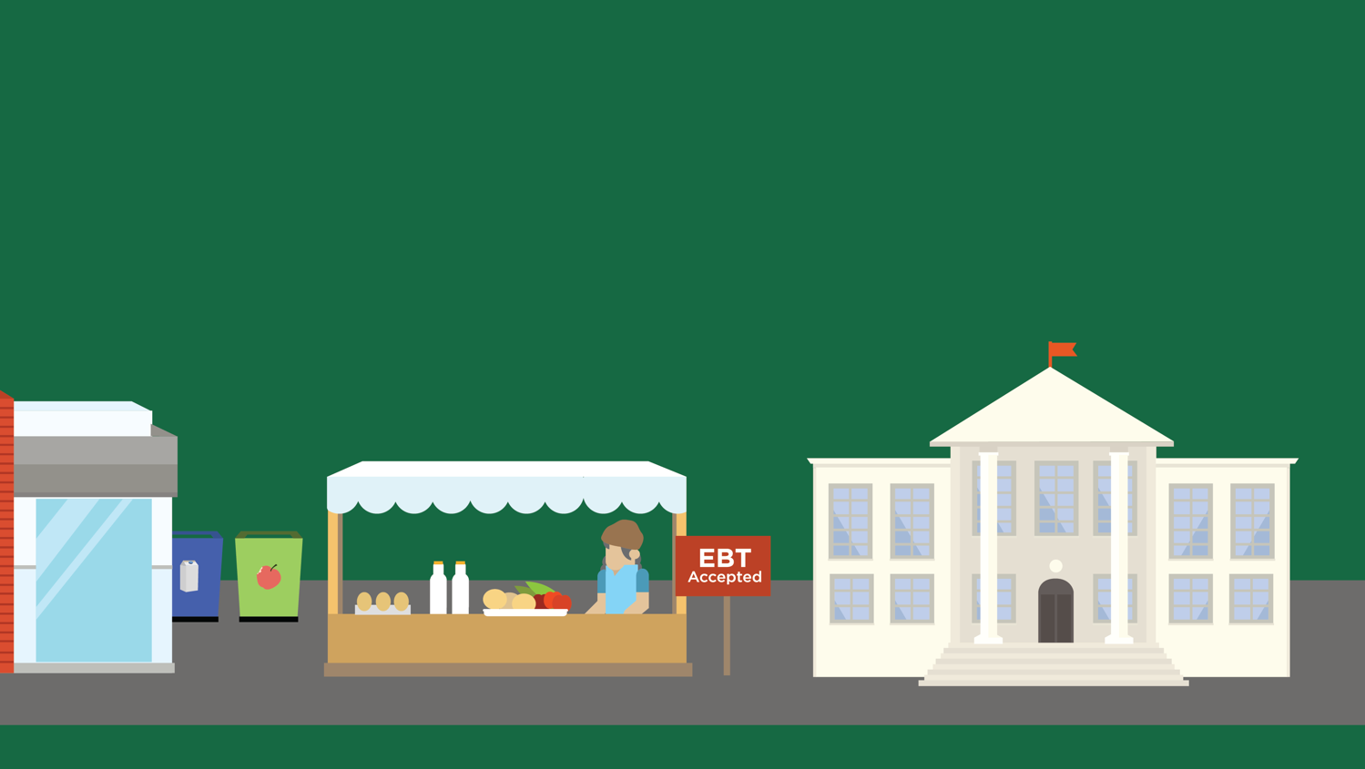
Lesson 15
Food Policy in Action
© 2020 Johns Hopkins University

Slide 2
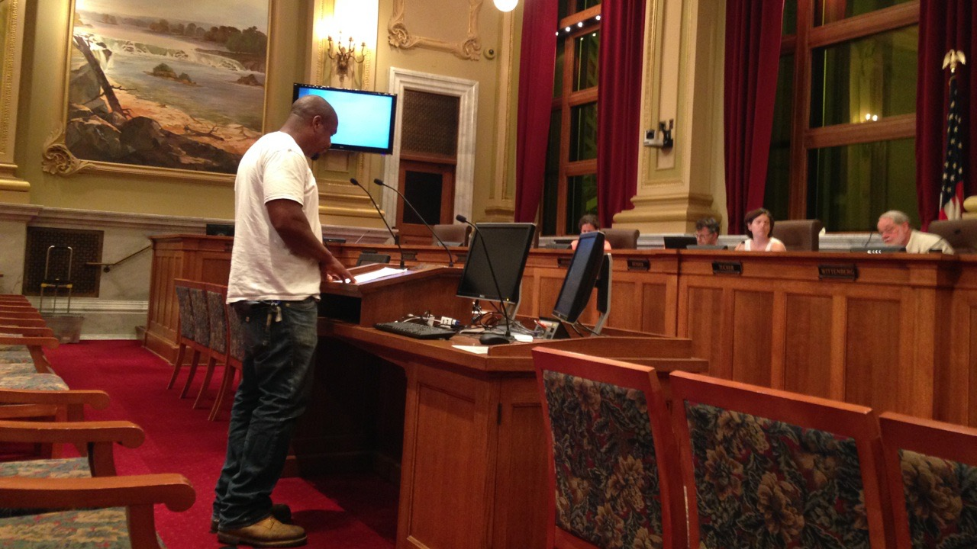
What does a food policy council do?
Looks for opportunities to improve the food system, particularly where food security is concerned
Provides policy recommendations to local, state, and federal governments
Reggie, an urban farmer, testifies before a Minneapolis City Council Committee to advocate for changing the urban agriculture policy.
Photo credit: Michelle Horovitz, CLF Food Policy Network Photo contest, 1st place winner "food policy process" category.

Slide 3
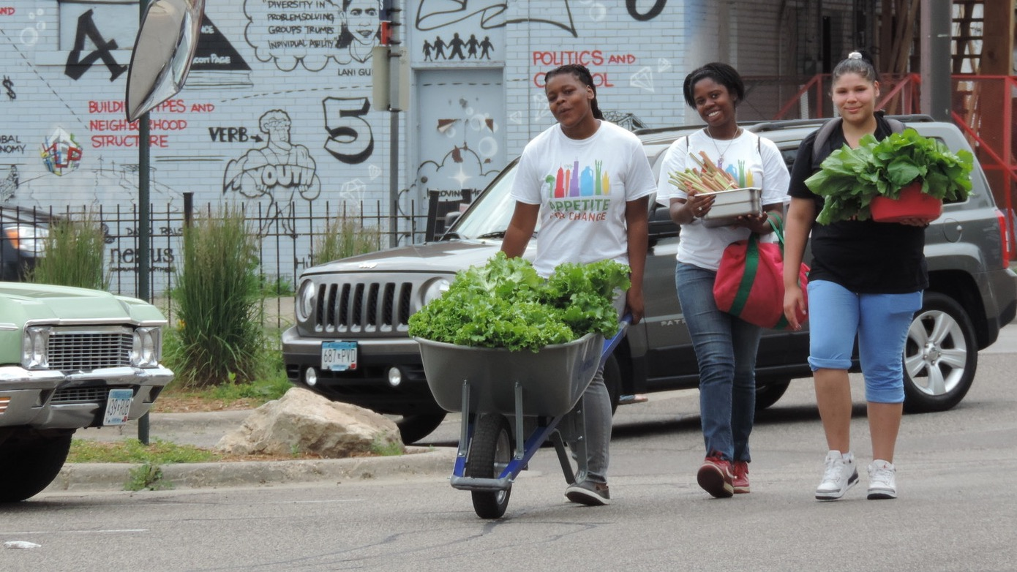
Who is part of a food policy council?
School food service director
Public health advocate
Hospital administrator
Anti-hunger advocate
City planner
Supermarket manager
Restaurant owner
Community member
Farmer
Labor representative
Environmental non-profit representative
Photo credit: DeVon Nolen, CLF Food Policy Network Photo contest, 2nd place winner "food policy in action" category.

