Slide 1
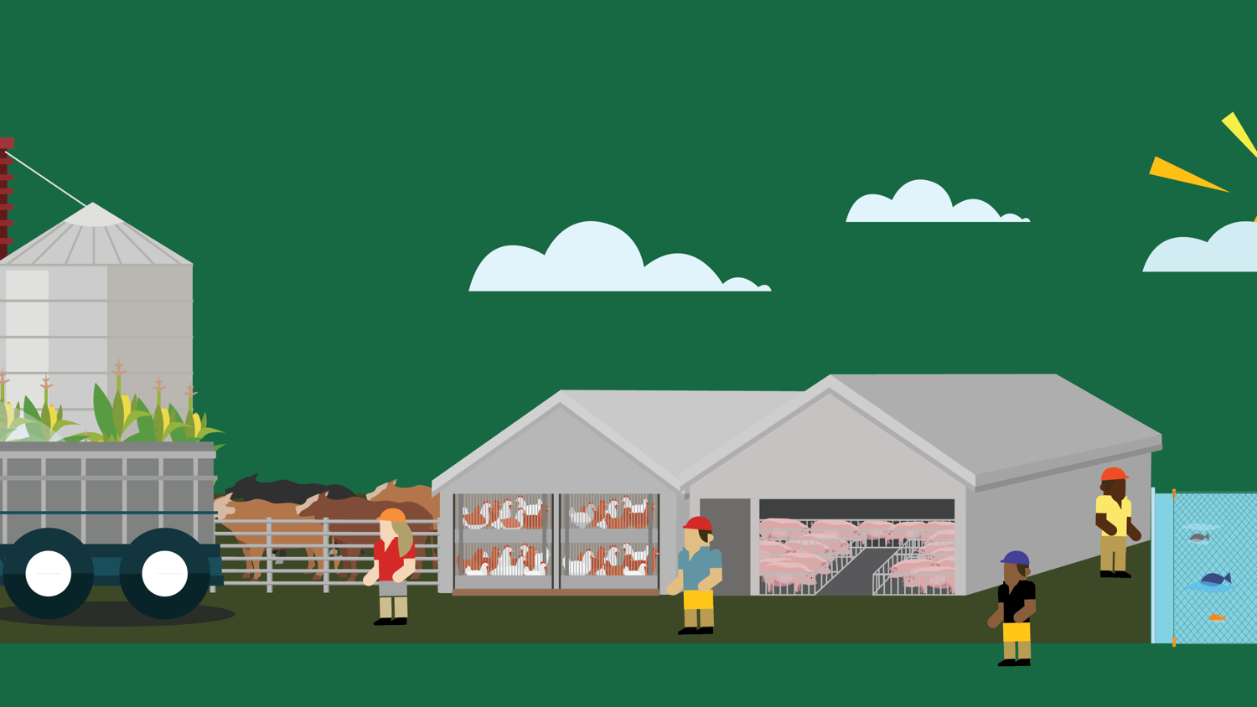
Lesson 2
Animals: Field to Factory
© 2020 Johns Hopkins University

Slide 2
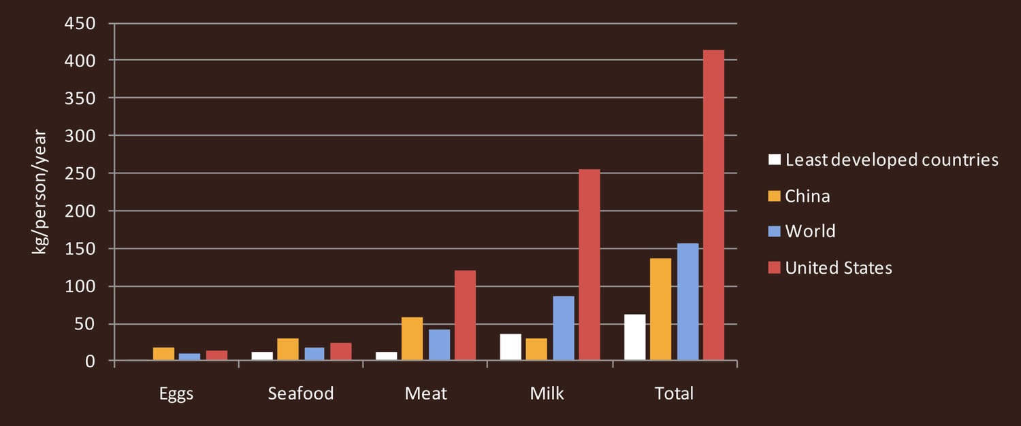
Global Animal Product Consumption
Average per capita availability of animal products, 2009
Data source: U.N. Food & Agriculture Organization. FAOSTAT. 2013.

Slide 3
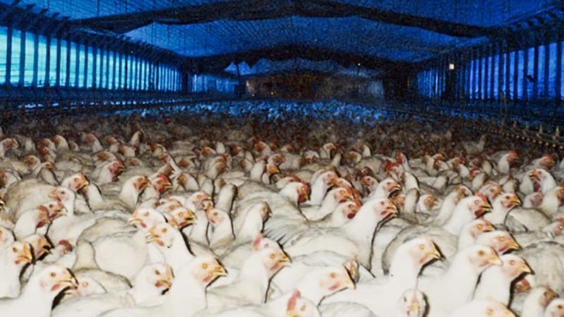
Chickens raised for meat
Photo credit: Farm Sanctuary. www.farmsanctuary.org.

Slide 4
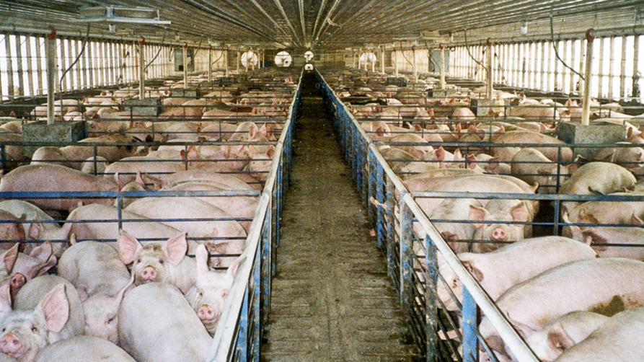
Hogs
Photo credit: Jeff Vanuga, USDA Natural Resources Conservation Service.

Slide 5
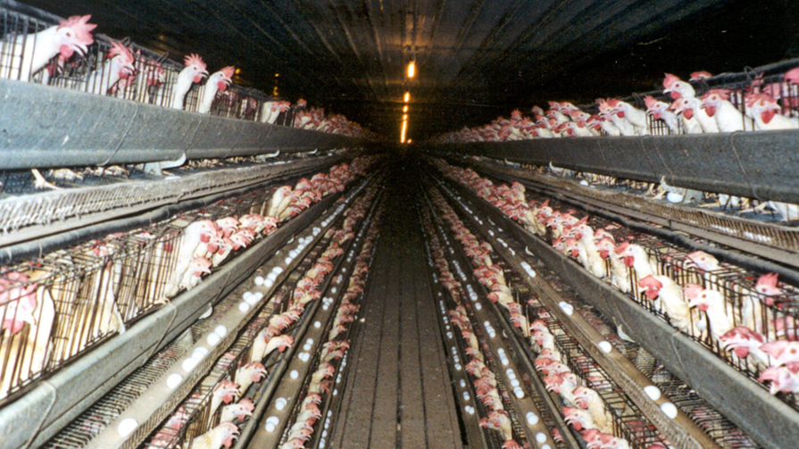
Laying hens
Photo credit: Farm Sanctuary. www.farmsanctuary.org.

Slide 6
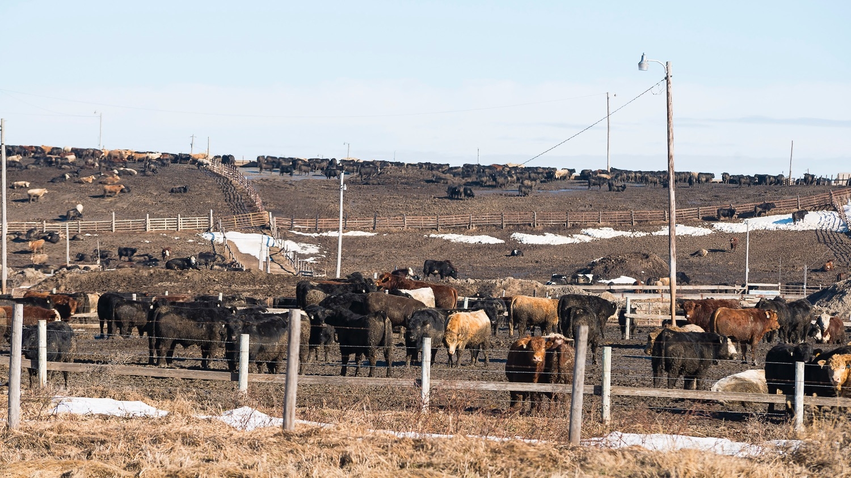
Beef cattle on feedlot
Photo credit: Michael Milli, CLF.

Slide 7
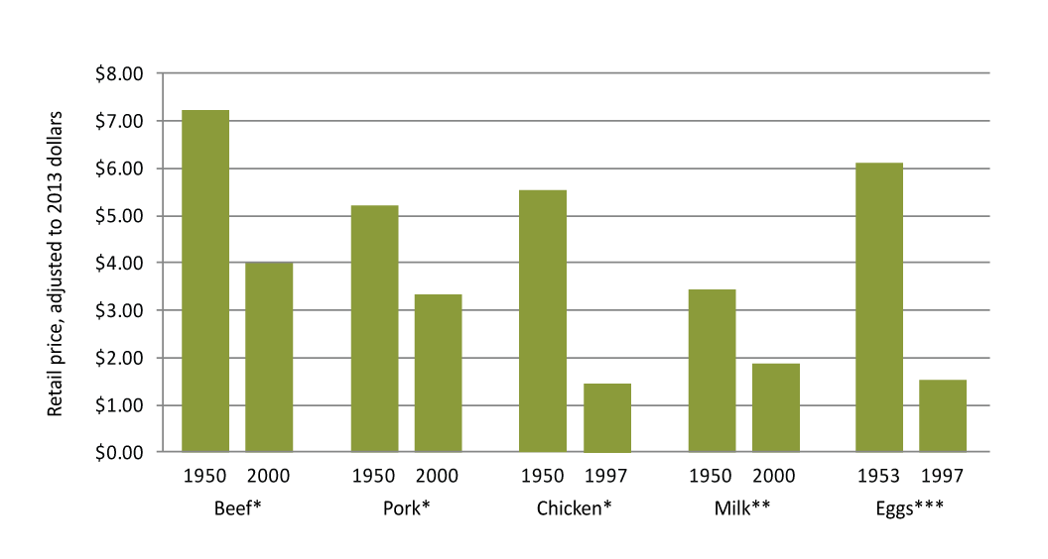
Animal Product Prices, 1950-2000
*Per pound, **Per half gallon, ***Per dozen. Data source: USDA Economic Research Service.

Slide 8
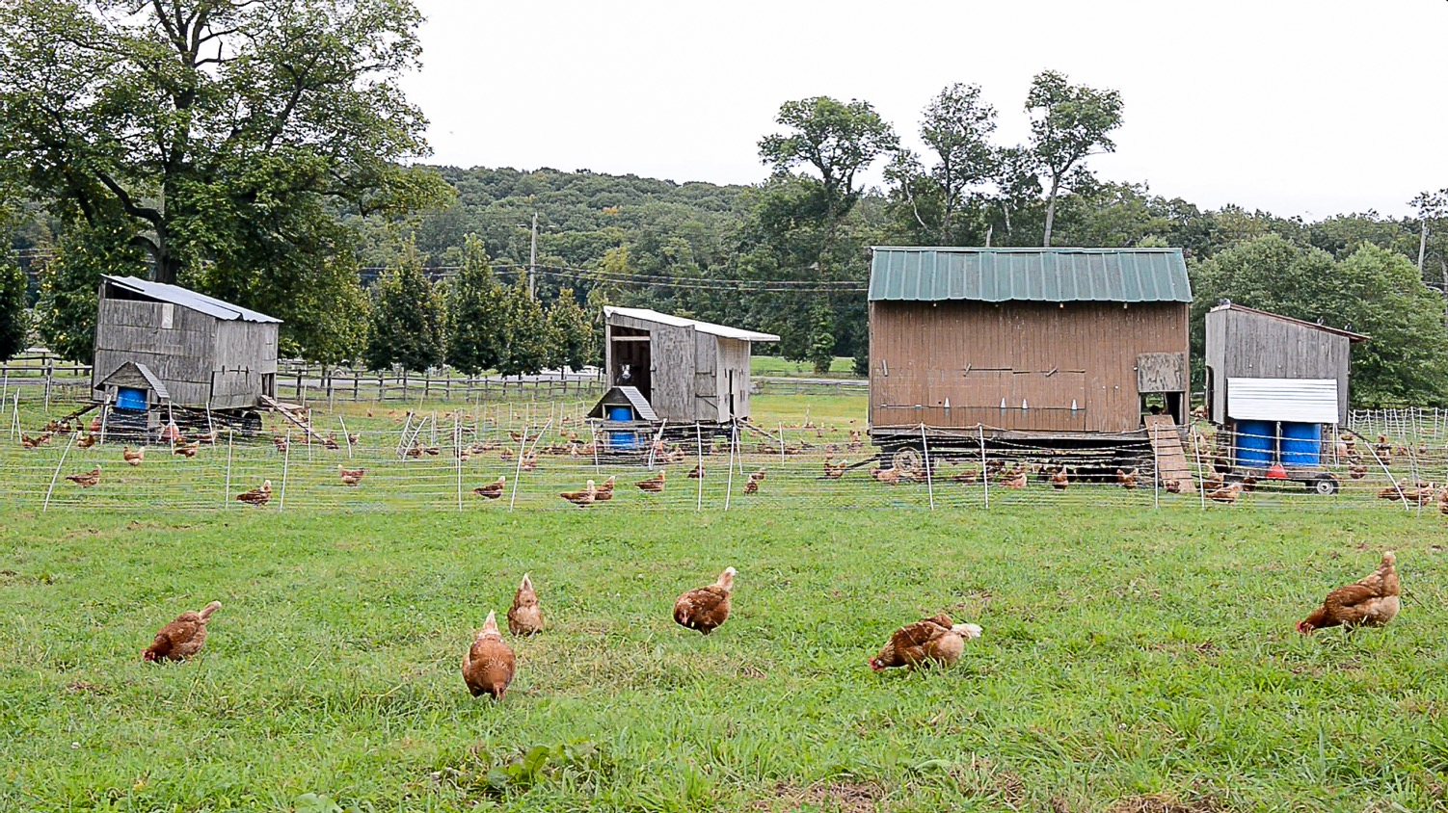
Ecological production-Chickens
Photo credit: Michael Milli, CLF.

Slide 9
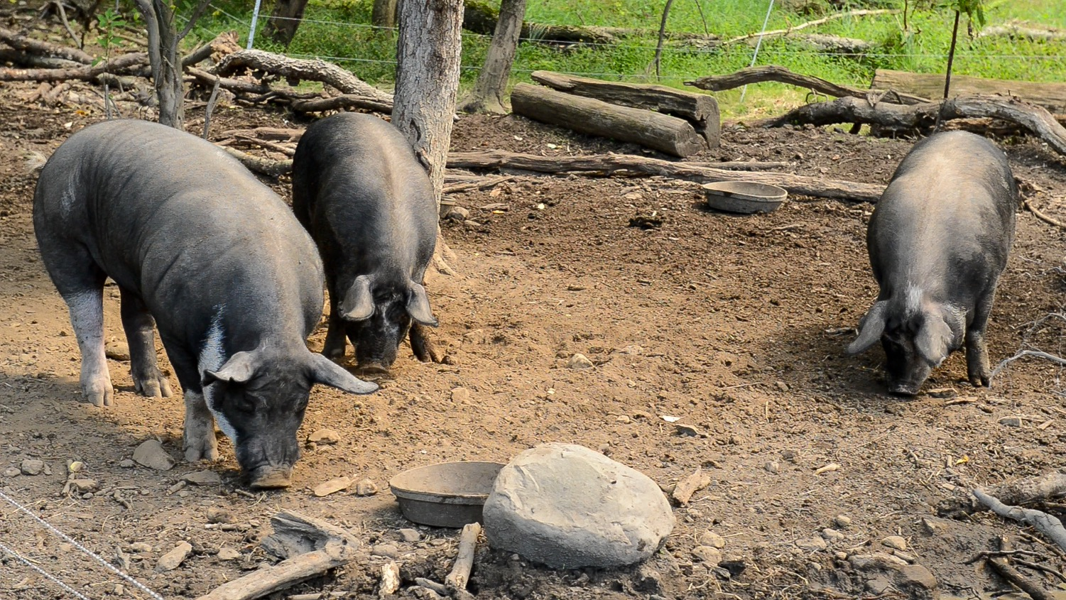
Ecological production-Hogs
Photo credit: Michael Milli, CLF.

