Slide 1
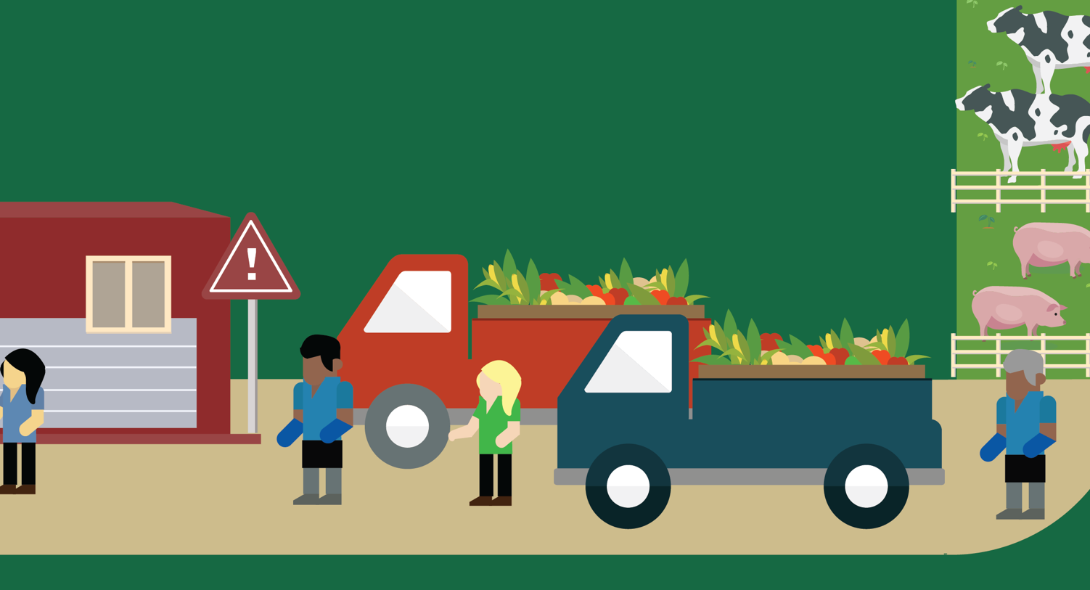

Lesson 7
Our Food’s Journey
© 2020 Johns Hopkins University

Slide 2
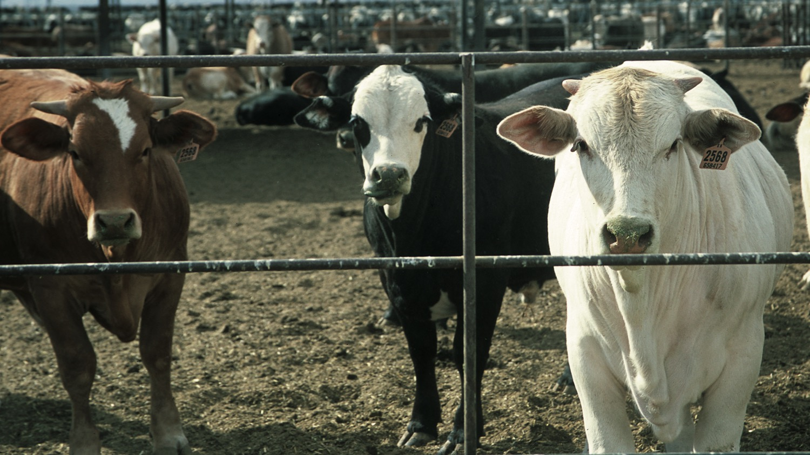
U.S. Food System
Greenhouse Gas Emissions
Photo credit: Jeff Vanuga, USDA Natural Resources Conservation Service.
Data source: Weber CL, Matthews HS. Food-miles and the relative climate impacts of food choices in the United States. Environ Sci Technol. 2008;42(10):3508-3513.

Slide 3
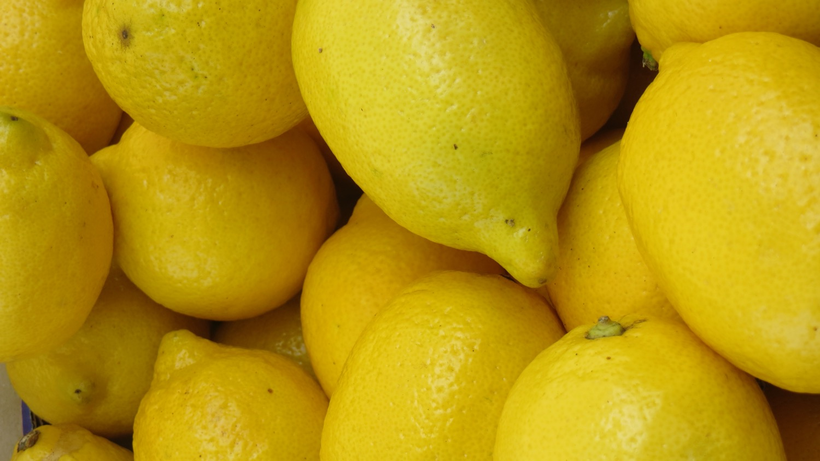
Top U.S. States in Fruit Production
California harvests about half of U.S. fruit.
Florida harvests almost one-fifth of U.S. fruit.
Photo credit: Leo Horrigan, CLF.
Data source: USDA, Economic Research Service using data from USDA, National Agricultural Statistics Service, Citrus Fruits 2010 Summary and Noncitrus Fruits and Nuts 2010 Preliminary Summary.

